Slide 1
W271 STATISTICAL MODEL WORK IN PROGRESS

Slide 2
IMPORTANT
What parameters characterize the models and how they are different from those models you have encountered? Think beyond the mean and standard deviation
What conditions are needed in the derivation of the MLE of the parameters of the model? There are many statistical packages make many estimation methods readily available. However, the assumption of an underlying model being estimated using functions are often forgotten
Hat denotes estimator
Common work flow: Check PMF, PDF. Confirm where CLT applies. What are parameters you are interested in? Create estimate for them. Check assumptions for the estimates. Check CI. Hypothesis Testing.
The statistical analysis workflow: Specify population model, Estimate model parameters, Test Model Assumptions (Ask whether our data looks like a sample that could come from our model)

Slide 3
TO REVIEW
1.3.2 HYPOTHESIS TESTS FOR PI

Slide 4
Key Ideas
Unit1
Categorical data, Bernoulli probability model, and Binomial probability model
Simulating a binomial probability model
Estimating the Binomial probability model (pi) using MLE
Confidence intervals (Wald CI and Alternative CIs)
Hypothesis test for the probability of success (incl. LRT)
Two binary variables
Contingency tables => very useful for EDA
Relative risks, odds, odds ratios

Slide 5
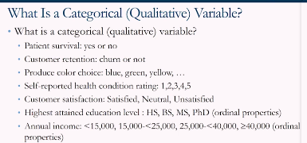
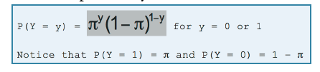
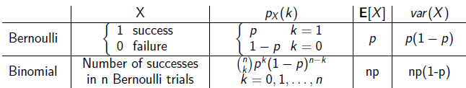

Discrete R.V. to model categorical variable
Unit1
Discrete Random Variables (⬄ Continuous Random Variables )
Bernoulli Distribution
Binomial Distribution
We are interested in pi: probability of success
Probability Mass Function
The first three examples do not have a natural ordering, and the last four examples have a natural ordering. We call them ordinal variables.
Binomial Coefficient

Slide 6
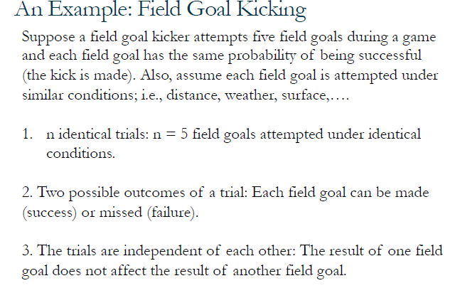
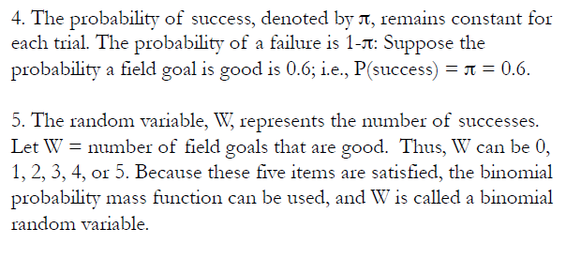
Required conditions when applying binomial probability model
Unit1
There are n identical trials
Each trial has two possible outcomes
The trials are independent of each other
The probability of success, denoted by pi, remains constant for each trial.
The random variable, W, represents the number of successes

Slide 7
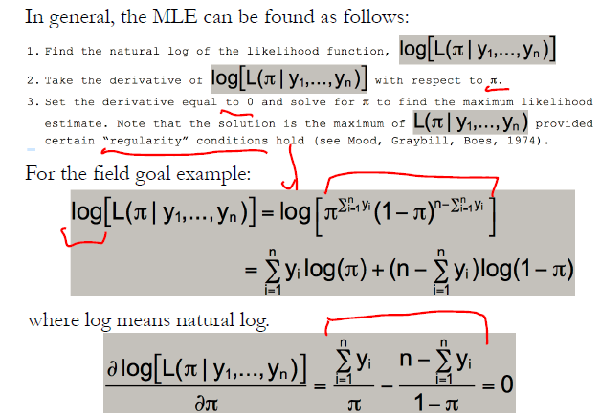
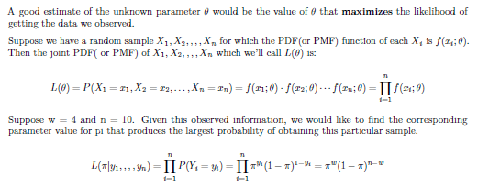
Finding MLE in General
Unit1

Slide 8
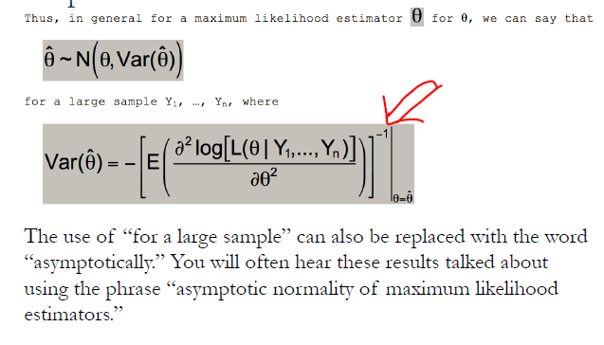
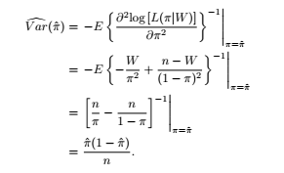
Properties of MLE
Unit1
For large sample,
Asymptotic normality: MLE can be treated as normal random variable.
=> Enables CI construction and Hypothesis testing
The variance of the MLE can be computed from the second derivative of the log likelihood function.

Slide 9
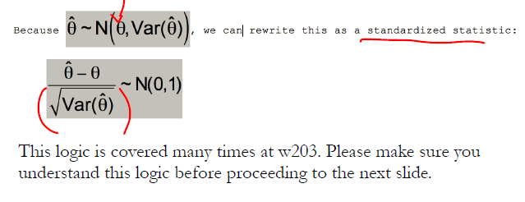
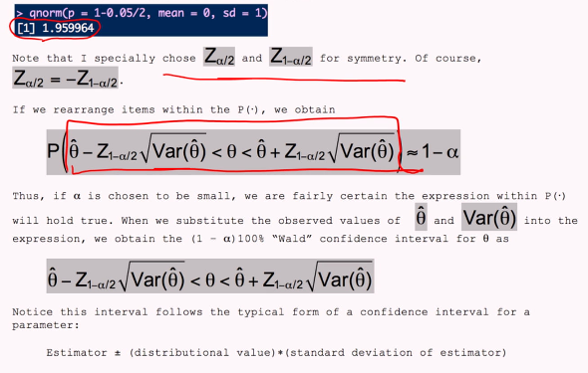
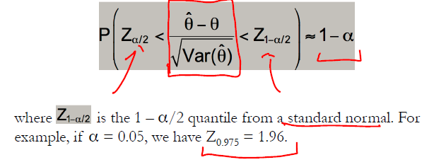
Wald Confidence Interval
Unit1
Z: Critical value!

Slide 10
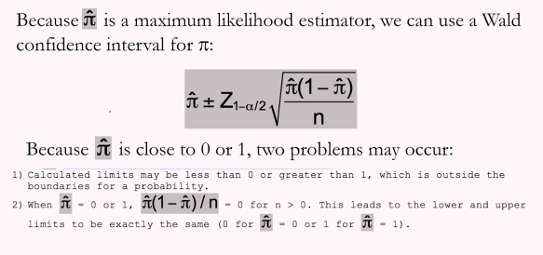
Potential problem of Wald Confidence Interval
Unit1

Slide 11
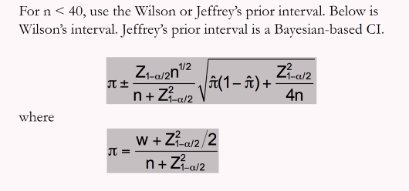
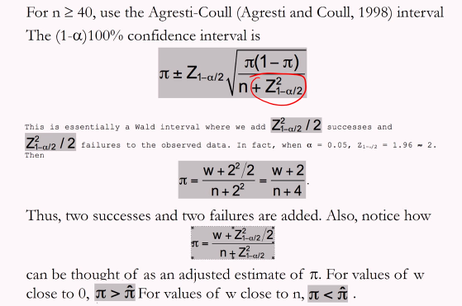
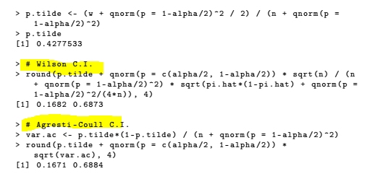
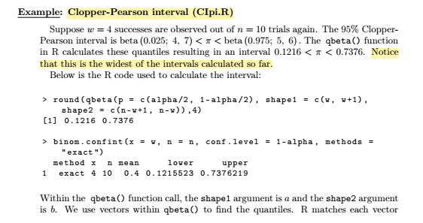
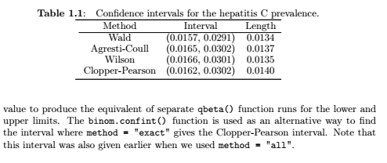
Alternative Confidence Intervals
Unit1
For n < 40,
Wilson’s interval
Jeffrey’s prior interval (Bayesian-based CI)
For n > 40,
Agresti-Coulli interval

Slide 12
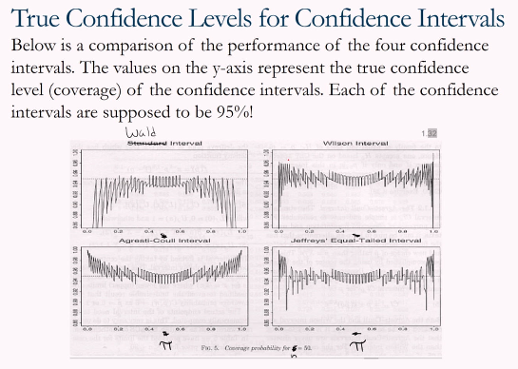
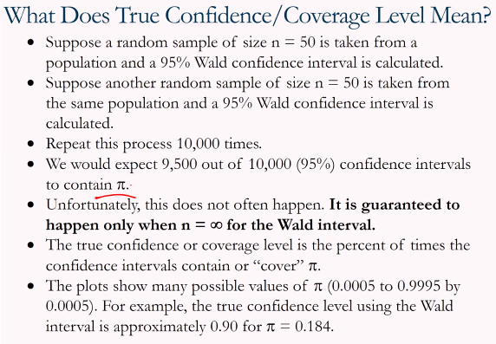
True Confidence / Coverage Level?
Unit1
Assume we repeat the process of constructing 95% CI for 100 times. We would expect 95 out of 100 confidence intervals to contain true pi. But a number of the CI contains true pi is lower than 95.

Slide 13
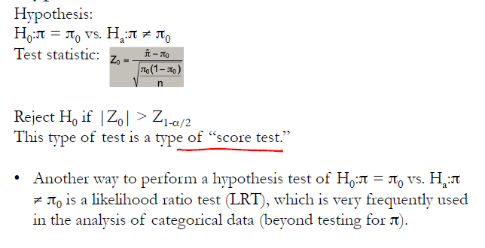
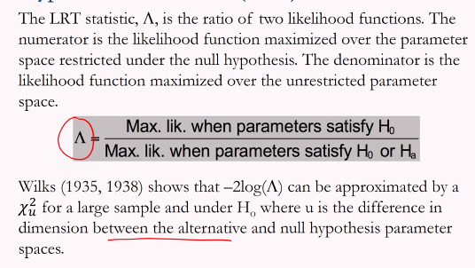
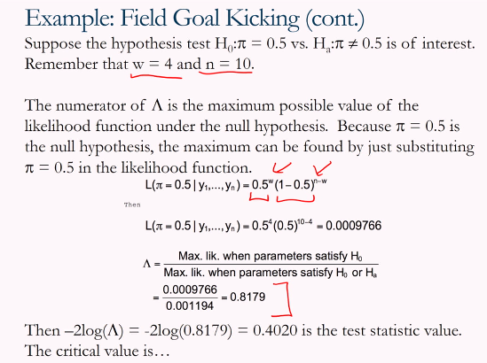
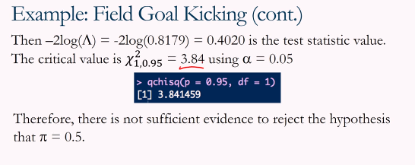
Hypothesis Tests for pi Likelihood ratio test(LRT) … often used for categorical data
Unit1

Slide 14
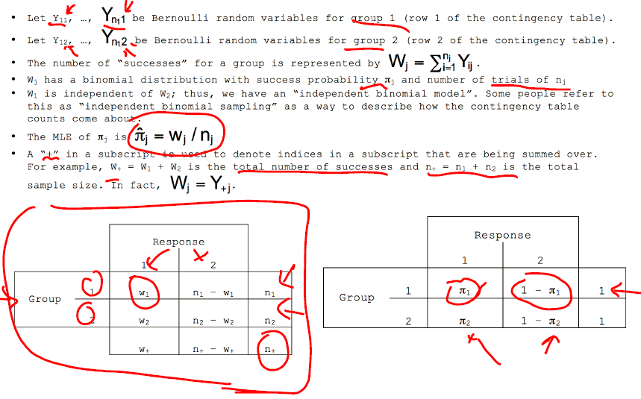
Multiple Binary Variables – Contingency Table
Unit1

Slide 15
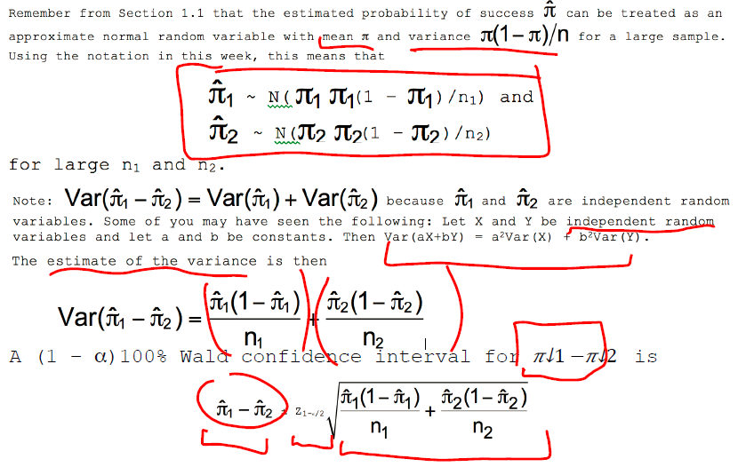
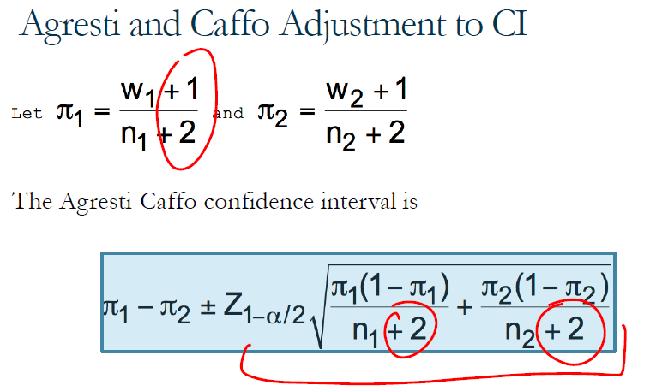
Confidence Intervals for the Difference of Two probabilities – Wald /
Unit1

Slide 16
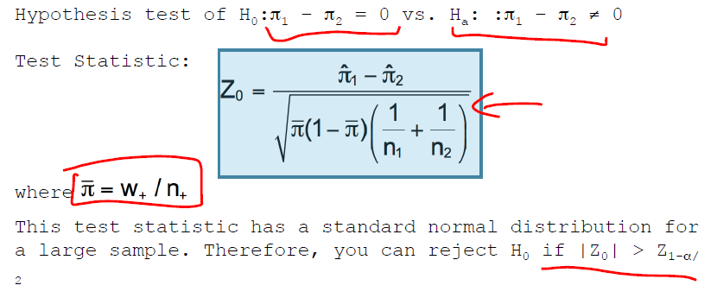
Testing the Difference of Two probabilities
Unit1

Slide 17
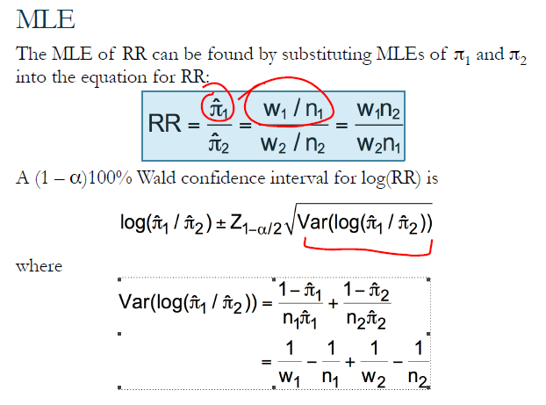
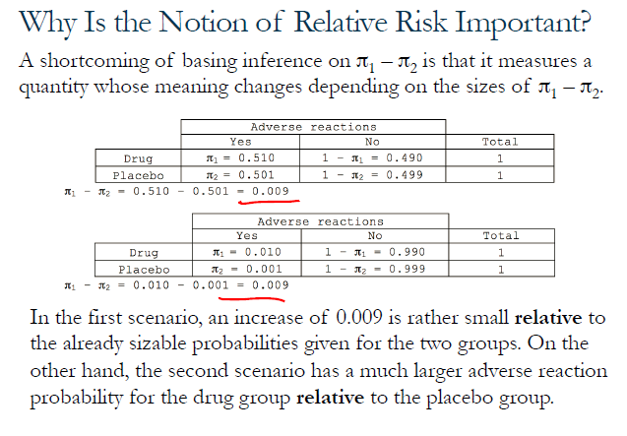
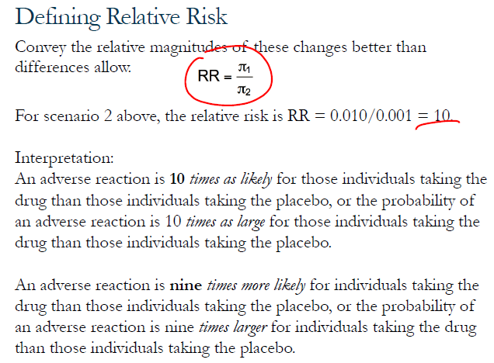
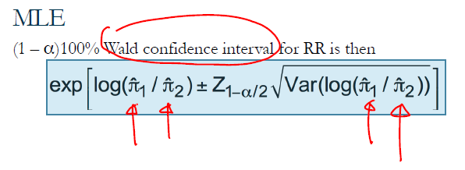
Relative Risk
Unit1

Slide 18
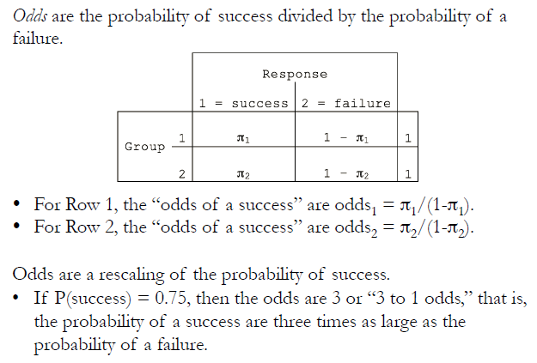
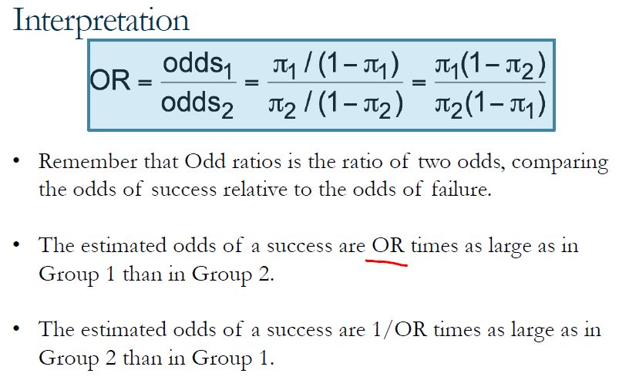
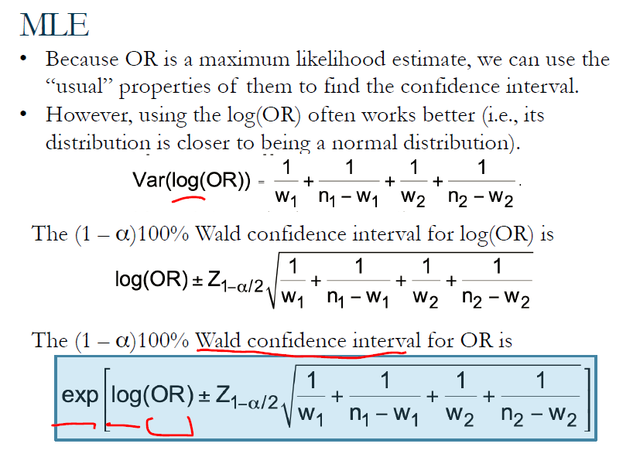
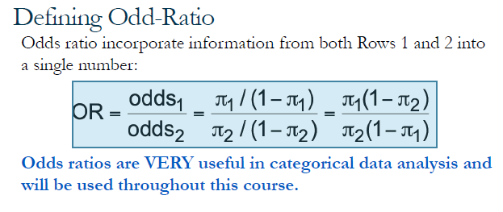
Odds
Unit1

